Slide 1
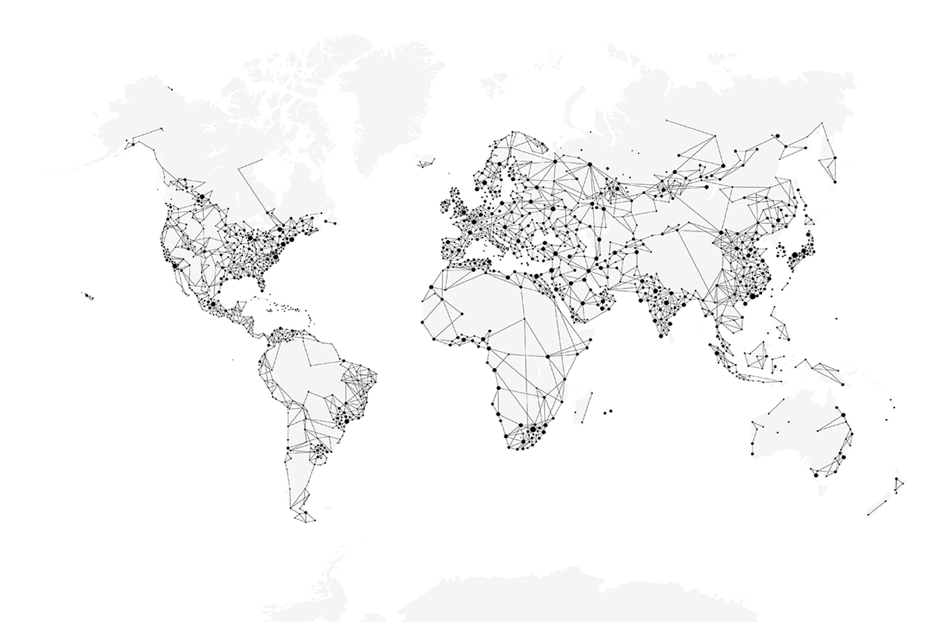

____________( Heading)
________________( Business/Division)
____________ 2025 ( Date)
Classification: Internal

Slide 2
Production Planning
A systematic approach to organizing resources, machines & materials — ensuring the right parts are produced at the right time, in the right quantity.
KEY ELEMENTS OF PRODUCTION PLANNING
📦 Demand (Indent)
⚙️ Capacity
🗃️ Inventory
How much needs to be made daily / monthly
How many hours machines can run
How many parts are already in stock
📅 Scheduling
🔧 Resources
📋 Rules
Which part to make first, on which machine
Machines, tools, colors & terminals needed
Safety stock limits & machine restrictions
BENEFITS OF GOOD PLANNING
✅ Smooth Operations
✅ Machines Fully Used
✅ Less Waste
✅ On-Time Delivery
✅ Lower Costs
‹#›/19
Classification: Internal

Slide 3
Production Planning — Common Challenges
6 Critical Pain Points Impacting Production Efficiency
🔴
Machine Breakdowns
🔵
Labour Issues
Equipment failure disrupts schedules & forces replanning.
Shortage of skilled operators or unexpected absenteeism affects capacity.
🟠
Material Shortages
🟣
Data Accuracy
Raw materials or terminals may not arrive on time, blocking production.
Wrong or missing information in planning leads to poor decisions.
🟡
High Changeover Times
⚪
Coordination Gaps
Switching machines between different parts/colors consumes valuable hours.
Miscommunication between planning, procurement & shop floor teams.
⚡ These challenges lead to production delays, cost overruns & missed deliveries — demanding a smarter scheduling solution
‹#›/19
Classification: Internal

Slide 4
Where We Are and Where We Want to Be
❌ CURRENT STATE
⚠️ GAP / CHALLENGE
✅ FUTURE STATE
👥 Manual Planning
⏱ Time-Consuming
🤖 Fully Automated
Done by 2–3 people; slow & time-consuming
Manual work takes hours daily
Digital scheduling with real-time data
→
→
📉 Inventory Issues
⚖️ Imbalanced Stock
📦 3-Day Safety Stock
Parts overproduced or face shortages
Some excess, some shortage
Consistent buffer maintained always
⚙️ Machine Tracking
🔍 No Utilisation Data
📊 Optimised Planning
No visibility on utilisation or downtime
Machines left idle or on PDT
Data-driven, efficient allocation
🎯 Digital Production Scheduling bridges this gap — transforming manual, reactive planning into automated, proactive execution
‹#›/19
Classification: Internal

Slide 5
Digital Production Scheduling
Smart · Automated · Real-Time
🤖 A smart, automated system that creates production plans using real-time data from demand (indents), inventory & machine capacity
🔧 WHAT PROBLEMS IT SOLVES
🚀 WHY IT SHOULD BE USED
✖ Removes manual planning
✔ Faster & accurate plans
Slow, error-prone processes eliminated
No human delays or errors in scheduling
✖ Balances demand vs hours
✔ Clear production visibility
Machine hours matched to actual demand
Know what to make, when and how much
✖ Reduces over/under stock
✔ Better machine utilisation
Safety stock maintained automatically
Fewer idle hours, higher throughput
✖ Tracks utilisation
✔ Lower costs
Full visibility on machine uptime
Smoother shop floor operations
✖ Cuts changeover waste
✔ Easy to adapt
Parts grouped to minimise setups
Adjusts when demand or machines change
‹#›/19
Classification: Internal

Slide 6
Where to Implement?
🏭 Implementation Area: MOULDING SECTION — Injection Moulding Division, Uno Minda Rika Pvt. Ltd.
Why the Moulding Section Was Selected
👥
Manual Planning:
Planning done by 2–3 people — slow & time-consuming
📦
Inventory Issues:
Some parts overproduced; others face shortages — causing imbalance
⚙️
Machine Utilisation Gaps:
No proper tracking; machines remain idle or on downtime undetected
🎯
High Impact Area:
Moulding is a critical stage — improvements here directly affect overall efficiency
🤖
Best Fit for Automation:
Clear demand signals, measurable machine hours & visible inventory — ideal for digital scheduling
✅ This section has the biggest gaps AND the clearest data — making it the perfect starting point for digital scheduling
‹#›/19
Classification: Internal

Slide 7
Expected Outcomes & Business Impact
Reduced Manual Effort — Eliminates 2–3 person daily planning workload; schedules generated in minutes, not hours.
Optimised Inventory Levels — Consistent 3-day safety stock maintained; over-production and shortages eliminated.
Higher Machine Utilisation — Full 22-hour daily capacity utilised; idle time and unplanned downtime minimised.
Fewer Changeovers — Daily limit of 25; same-colour grouping reduces setup time and material waste.
On-Time Delivery — Proactive scheduling ensures parts are ready when needed; customer commitments met reliably.
Lower Operational Costs — Reduced waste, fewer emergency interventions, and better resource allocation drive cost savings.
‹#›/19
Classification: Internal

Slide 8
Constraints Implemented in Digital Production Scheduling
Maintain Safety Stock
Full Capacity Utilization
Fixed Machine Allocation
Plan According To Category
Minimum Changeover
Terminal Availability
‹#›/19
Classification: Internal

Slide 9
Constraint 1 — Maintain Safety Stock
🎯 Maintain a minimum 3-day safety stock for all parts — ensuring uninterrupted production flow against downtime, demand fluctuations & supply disruptions
TARGET STOCK: 3 Days Safety Stock + 2 Days Rolling Stock = 5 Days Total Buffer
1–2 Days CRITICAL
2–3 Days SAFETY STOCK
4 Days ROLLING STOCK
5 Days TARGET LEVEL
← 0 Stock
Safety Zone →
Rolling Zone →
← Target
PRODUCTION SCENARIOS BASED ON STOCK LEVEL
Case 0 | Stock < 1 Day
S–1 | Stock 1–3 Days
S–2 | Stock > 3 Days
🚨 Urgent Production
⚠️ Balance Shortage
✅ Maintain Flow
Stop everything — produce immediately
Prioritise short parts while keeping stable parts running
Keep production flowing; optimise machine efficiency
‹#›/19
Classification: Internal

Slide 10
Constraint 2 — Plan According to Category
🏷️ Schedule production based on part type — balancing fast-moving & slow-moving items by classifying into Runners, Repeaters & Strangers
CATEGORIES
🏃 RUNNER
🔁 REPEATER
🔮 STRANGER
Fast-moving parts High demand Produced frequently
Moderate demand Produced regularly but not daily
Slow-moving parts Low demand Produced occasionally
→ PRIORITISE FREQUENTLY
→ PLAN AT INTERVALS
→ PLAN STRATEGICALLY
High Indent Frequent Production
Regular Planning Avoid Shortages
Occasional Demand Slow Moving
‹#›/19

Slide 11
Constraint 3 — Full Capacity Utilization
⏱ 2 Shifts × 12h | 1h Break Each = 11h per Shift = 22 Available Hours per Day
Ensure all machine hours are fully utilised — maximising productivity and minimising idle time by balancing workloads across all machines.
DAILY CAPACITY BREAKDOWN
Shift 1 11h
Shift 1 • 11h Active
Shift 2 11h
⏸
Shift 2 • 11h Active
⏸
SCHEDULING FLOW
1 Total Available Hours = 22
2 Subtract Downtime & Changeover
3 Allocate Parts to Machines
4 Balance Workload Across Machines
✓ Full Capacity Utilisation Achieved!
‹#›/19

Slide 12
Constraint 4 — Fixed Machine Allocation
🔒 Machines assigned to certain parts always run ONLY those parts and are excluded from planning & reallocation. Keeping them dedicated saves time, reduces changeover costs & keeps production steady.
⏱ Saves Time
💰 Reduces Costs
📈 Steady Output
🎯 Full Capacity
No replanning needed for fixed machines
No changeover expense for dedicated parts
Consistent production flow maintained
Parts needing 100% machine capacity handled
DECISION LOGIC
🔍 Check Each Machine
Is the Machine Fixed?
⛔ Skip It! (Do Not Reallocate)
YES
NO
✅ Plan Parts on It (Include in Schedule)
‹#›/19

Slide 13
Constraint 5 — Minimum Changeover
⚡ Daily Changeover Limit = 25 | Group same-color parts together to minimise machine reconfiguration time & cost
Intelligently sequences parts to minimise setups — ensuring machines spend more hours PRODUCING rather than stopping for reconfiguration.
IMPACT OF MINIMISING CHANGEOVERS
🕐 Less Downtime
💰 Lower Cost
🎨 Color Grouping
📊 Better Utilisation
Machines run longer without stops
Fewer setup resources & labour needed
Same-color parts batched together
More hours producing, less setting up
CHANGEOVER DECISION FLOW
Daily Limit = 25 Changeovers Set
Within Limit?
📅 Shift to Next Day
NO →
YES ↓
🎨 Group Same Color Parts
✅ Allocate Parts to Machines
‹#›/19

Slide 14
Constraint 6 — Terminal Availability
🔌 Parts are scheduled ONLY when ALL required terminals are available — preventing interruptions, bottlenecks & scheduling conflicts. If even ONE terminal is unavailable (downtime/overload/maintenance), the part is held until all are active.
Each part depends on specific terminals
System checks availability before confirming plan
ONE missing terminal = part is NOT scheduled
Prevents errors, bottlenecks & delays
TERMINAL AVAILABILITY CHECK LOGIC
🔌 Terminals Required For a Part
All Terminals Available?
✅ Plan This Part (Schedule Confirmed)
YES →
NO ↓
⛔ Skip to Other Parts (Re-check Later)
↺ Hold until all terminals are active
‹#›/19

Slide 15
Summary — 6 Constraints at a Glance
C1 — Maintain Safety Stock
5-day buffer (3-day safety + 2-day rolling) maintained at all times to prevent stockouts.
C2 — Plan According to Category
Parts classified as Runners, Repeaters & Strangers for priority-based scheduling.
C3 — Full Capacity Utilization
22 available hours/day (2 shifts × 11h) fully allocated — no idle machine time.
C4 — Fixed Machine Allocation
Dedicated machines for specific parts are locked out of replanning — reducing changeover cost.
C5 — Minimum Changeover
Daily changeover limit of 25; same-color parts batched to cut setup time & cost.
C6 — Terminal Availability
Parts scheduled only when all required terminals are active — prevents bottlenecks & delays.
✅ All 6 constraints work together to create a smart, automated, conflict-free production schedule
‹#›/19

Slide 16
WHAT THIS PRESENTATION COVERS
10 constraints — each explained with the problem it solves, the mechanism, and the flowchart
C1
Inventory Health
C6
Minimum Tools
5-Day target with safety floor & ceiling
1→2→3 tool escalation logic
C2
Priority Scoring
C7
Serial Tool-Changer
Urgency-first assignment, displacement pass
Structural no-overlap guarantee
C3
22-Hour Rule
C8
Minimum Run Block
Two-shift planning with hard ceiling
4-hour effective production floor
C4
Specialised Machines
C9
No Machine Idle
Part-count based machine ranking
90% utilisation enforcer — uncapped extension
C5
Same-Part Continuation
C10
Colour Grouping
Changeover minimisation & queue stagger
10-min purge penalty & colour-aware ranking
‹#›/19
Classification: Internal
Smart APS V9 | Uno Minda Rika Private Limited | Injection Moulding Division

Slide 17
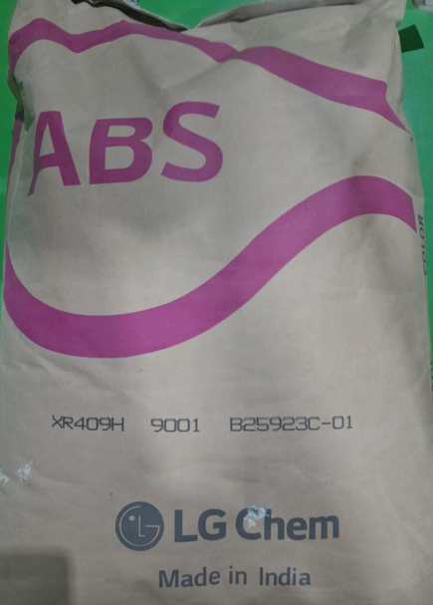
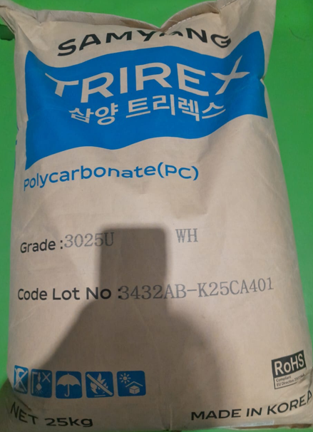
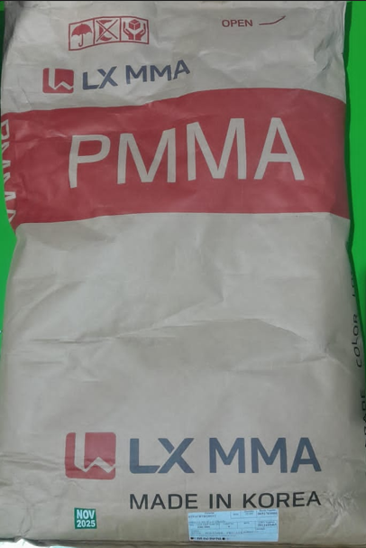
14SW210301-00004X1 KNOB PWS CP
RTPABSBKG0027Y
ABS XR-409H (BLACK) OF LG
RTPPOCWHG0012Y
PC-TRIREX 3025U(WHITE) OF SAMYANG
RTPACRTRG0012Y
PMMA I.G. 840 OF L.G. (TRANS)
‹#›/19
Classification: Internal

Slide 18
Next Steps & Implementation Roadmap
Phase 1 — Pilot Implementation (Month 1–2)
Deploy Digital Production Scheduling in Moulding Section. Validate with live data, calibrate safety stock targets, and train the planning team.
Phase 2 — Performance Review & Optimisation (Month 3–4)
Measure KPIs: machine utilisation, inventory accuracy, changeover count. Fine-tune constraint parameters based on real-world results.
Phase 3 — Full-Scale Rollout (Month 5–6)
Extend solution to other departments. Integrate with ERP/MES for end-to-end digital scheduling across Uno Minda Rika Pvt. Ltd.
‹#›/19
Classification: Internal

Slide 19





Thank You
Corporate Office
Address: Village Nawada Fatehpur,
P.O. Sikanderpur Badda, Manesar,
Gurgaon – 122004, India.
Website: www.unominda.com
Email ID: xxxx@unominda.com
Follow us on social media. Links below
‹#›/19
Classification: Internal

